Slide 1


Environmental Monitoring System
By: Zara Moinuddin & Sofia Yang

Slide 2
Problem Statement
Develop a monitoring and notification system for logging air quality statistics and pollution and alert when logged metrics fall to unsafe levels.

Slide 3
Research & Investigation
Temperature & Humidity sensor:
Digital Output relative humidity and temperature sensor
Uses a capacitive humidity sensor and a thermistor to measure the surrounding air, and sends a digital signal on the data pin
Power − 3-5V
Max Current − 2.5mA
Humidity − 0-100%, 2-5% accuracy
Temperature − 40 to 80°C, ±0.5°C accuracy

Slide 4
Research & Investigation (cont)
Air Quality Detection Sensor:
Detects harmful gases like Ammonium, Sulfur, Benzene, and Carbon Dioxide
Included digital and analog output pins. When gas levels go over a threshold (set by potentiometer or code) limit the digital pin goes high.
Analog pin measures in PPM
Operates from 2.5V - 5V and consumes about 150 mA
Requires some preheating before it can give accurate results (30 sec - 4 min)

Slide 5
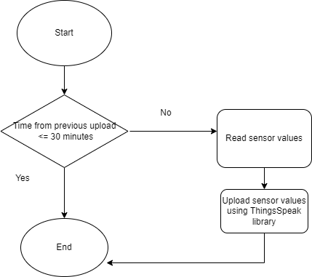
Potential Solutions
Data Collection Arduino Sketch
Collect data from sensor values
Upload to IOT platform.
Visualize Metrics & Notification System
Use MATLAB ThingsSpeak for visualization
Set trigger for alerts based on sensor values
Create webapp to display visualizations
Extra: Regression Model
Create Air Quality Index forecast ML model based on data
Use Microsoft Azure to deploy/train/run model
Flowchart of Arduino Sketch

Slide 6
List of Tasks
Breadboard the wire connections between the Arduino and sensors.
Write Arduino sketch to read sensor data and upload sensor values to ThingsSpeak IOT platform.
Setup ThingsSpeak platform for data visualization and notification system.
Create webapp with created charts/graphs of sensor value trends.

Slide 7
List of Parts
Material/Equipment | Notes
Breadboard ✓
+5V Power supply for breadboard ✓
Jumper wires ✓ | Not sure what quantity needed
Resistors ✓ | Need to see what ohm level resistors required
Capacitors ✗
Temperature and humidity sensor module ✗ | (From spreadsheet of available sensors)
Air Quality Detection Sensor (i.e MQ135) ✗ | Not on spreadsheet of available sensors
.

Slide 8
Deliverables and Timeline
Date | Expected Completion Goals
10/24 | Review proposal and required components Stretch goal: Start Arduino sketch for reading sensor values.
10/31 | (A) If sensors arrive: Start breadboarding process. (B) If sensors do not arrive: Complete rough Arduino sketch.
11/7 | Continue/Start breadboarding process. Stretch goal: Test/debug Arduino sketch.
11/14 | Setup and test ThingSpeak and notification system; Create web application.
11/21 (No Lab) | Continue testing system/work on ML components.
11/28 | Deliver final result.
Deliverables
1. Data visualization webapp
2. Metrics notification system
Stretch Goal:
ML air quality prediction model

Slide 9

Conclusion
Goal:
Develop a monitoring and notification system for environmental air quality + pollution metrics.
Applications:
Use insights collected for data analysis/ developing future solutions and public policy
Extra Goal:
Build a machine learning model to forecast air quality based on humidity/temperature/level of air pollution.

Slide 10
References:
Temperature and Humidity sensor:
https://create.arduino.cc/projecthub/sachendra003/arduino-humidity-sensor-288146
Air Quality detection sensor:
https://quartzcomponents.com/products/mq-135-air-quality-gas-sensor-module#:~:text=The%20MQ%2D135%20Gas%20sensor,the%20digital%20pin%20goes%20high.

